Slide 1

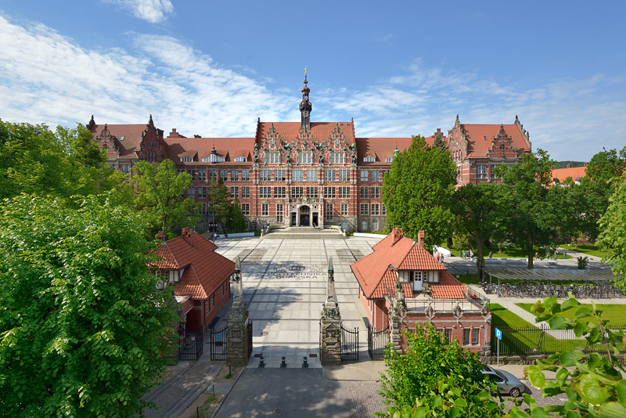
9th Erasmus Staff Training Week
Gdańsk Tech Library
2025
Open Science Competence Center at Gdansk Tech – a pathway to strengthening Open Science in Poland
Gdańsk University of Technology Main Building
Author: K. Krzempek https://pg.edu.pl/dzial-promocji/marka-pg/galeria-zdjec
Magdalena Szuflita-Żurawska
GDAŃSK TECH LIBRARY
E-mail: magdalena.szuflita@pg.edu.pl
https://pg.edu.pl/en/gdansk-tech-library

Slide 2
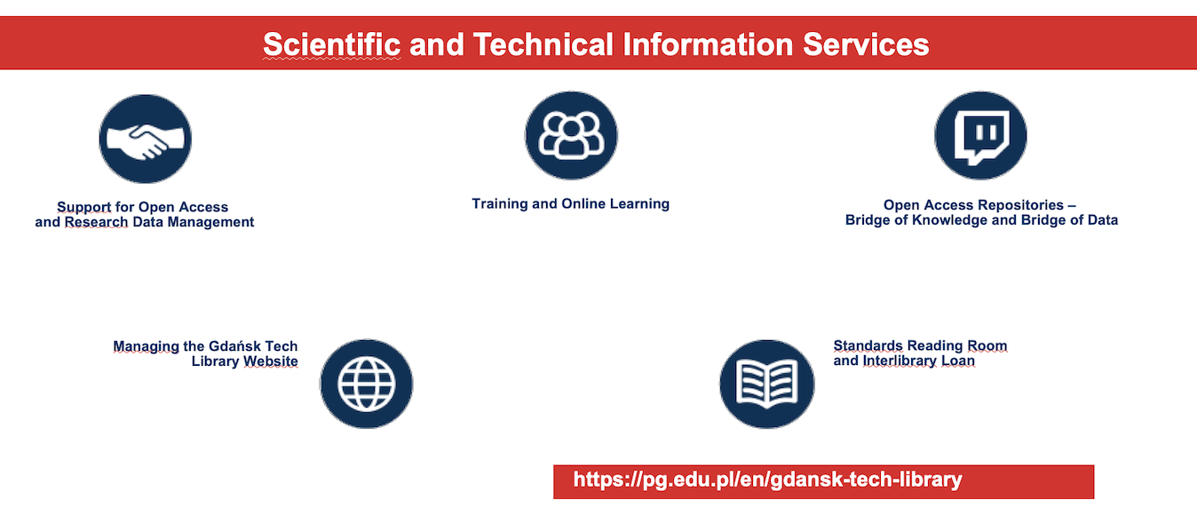
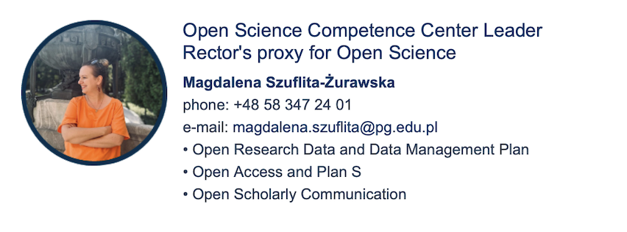
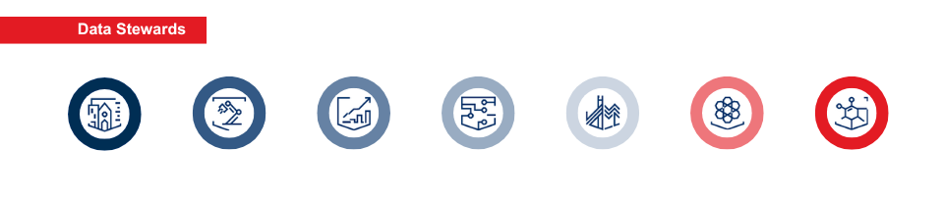
9th Erasmus Staff Training Week
Gdańsk Tech Library
2025

Slide 3
9th Erasmus Staff Training Week
Gdańsk Tech Library
2025
Open Science Policy in Poland – Key Points
National Open Access Policy (2015)
  Poland introduced its first national open access policy in 2015.
  It encourages open access to scientific publications and research data funded from public resources.
Ministry of Science and Higher Education Initiatives
  The Ministry supports repositories, open journals, and platforms for open data (e.g., POL-on, Otwarta Nauka).
  Promotes integration with European initiatives like OpenAIRE and Horizon Europe.
The National Science Centre (NCN) Requirements
  NCN mandates that results of publicly funded research (publications and data) be made openly available.
  Researchers are required to deposit their publications in open repositories.
Open Research Data
  The Polish scientific community is encouraged to share research data in line with FAIR principles (Findable, Accessible, Interoperable, Reusable).
  Implementation of Data Management Plans (DMPs) is becoming standard for funded projects.
https://pg.edu.pl/en/gdansk-tech-library

Slide 4
9th Erasmus Staff Training Week
Gdańsk Tech Library
2025
Open Science in Poland – EOSC-PL Highlights
Poland’s Commitment to Open Science
  National policies encourage open access to publicly funded research results.
  Key institutions like the National Science Centre require open publication and data sharing in line with FAIR principles.
EOSC-PL as Poland’s National Node
  Since March 2025, EOSC-PL has operated as Poland’s official node in the European Open Science Cloud (EOSC) Federation.
  It is co-developing EOSC’s rules and mechanisms with 12 other European nodes.
Institutional Partnership
  EOSC-PL is developed by four key partners:
  National Science Centre, Cyfronet AGH, Gdańsk University of Technology, and the University of Warsaw.
Federated Access and Interoperability
  EOSC-PL integrates Polish resources—data repositories, computing services, and analytical tools—into the EOSC Federation.
  It enables secure and seamless access via single sign-on and supports cross-border research collaboration.

Slide 5
9th Erasmus Staff Training Week
Gdańsk Tech Library
2025
The "Bridge of Data" Project
(Bridge of Data – Multidisciplinary Open System Transferring Knowledge. Stage II Open Research Data)
The project began in 2018 and focuses on the implementation of an Open Research Data (ORD) repository.
A key objective was the creation of the Open Science Competence Center (OSCC) at the Gdańsk University of Technology Library.
  The OSCC was established shortly after the project's launch, in autumn 2018.
The idea for the OSCC stemmed from:
  The global trend of data stewardship.
  Lessons learned during the earlier "Bridge of Knowledge" project (regarding Open Access)
The OSCC is:
  The first (and currently the only) competence center of its kind in Poland.
  Part of the national Polish EOSC (European Open Science Cloud) pilot node.
https://pg.edu.pl/en/gdansk-tech-library

Slide 6
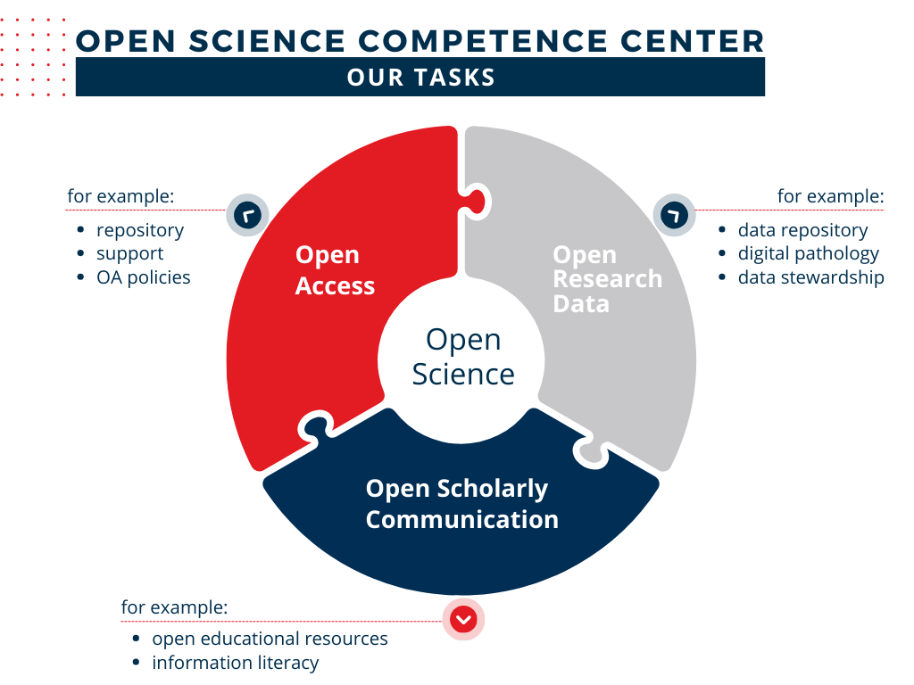
9th Erasmus Staff Training Week
Gdańsk Tech Library
2025
Podpis

Slide 7
9th Erasmus Staff Training Week
Gdańsk Tech Library
2025
The Center delivers a wide range of training programs, consultancy services, and promotional events supporting the development of Open Science.
Currently, a variety of tailored offerings are available to academic staff and doctoral students, including:
  Customized training sessions (e.g., discipline-specific modules),
  Individual, face-to-face consultations,
  Online webinars organized into thematic blocks, covering:
    Introduction to Open Research Data,
    Preparation of Data Management Plans (for national and EU grant applications),
    Legal aspects of research data (licensing, data protection, and data reuse),
    Practical use of the Bridge of Data Repository (dataset submission and management),
    FAIR principles for metadata and data quality,
    Open Access, Plan S: requirements, challenges, and implications.
https://pg.edu.pl/en/gdansk-tech-library

Slide 8
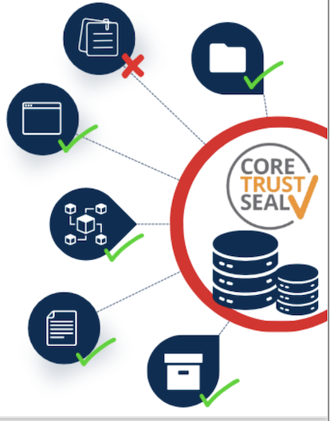
9th Erasmus Staff Training Week
Gdańsk Tech Library
2025
Support for Depositing Research Data in the Bridge of Data Repository
Open Research Data Catalogue)
Assistance with:
  Creating metadata for datasets,
  Selecting the appropriate license,
  Preparing data for public access,
  Adding new versions of datasets,
  Grouping datasets into collections.
Assessment of submitted datasets to ensure metadata completeness and quality.
Approval of verified datasets for publication in the repository.
Contribution to improving repository services and functionalities through:
  Collaboration with the IT department,
  Preparation of user guidelines and instructions,
  Participation in the certification processes (e.g., CoreTrustSeal quality certification).
https://pg.edu.pl/en/gdansk-tech-library

Slide 10
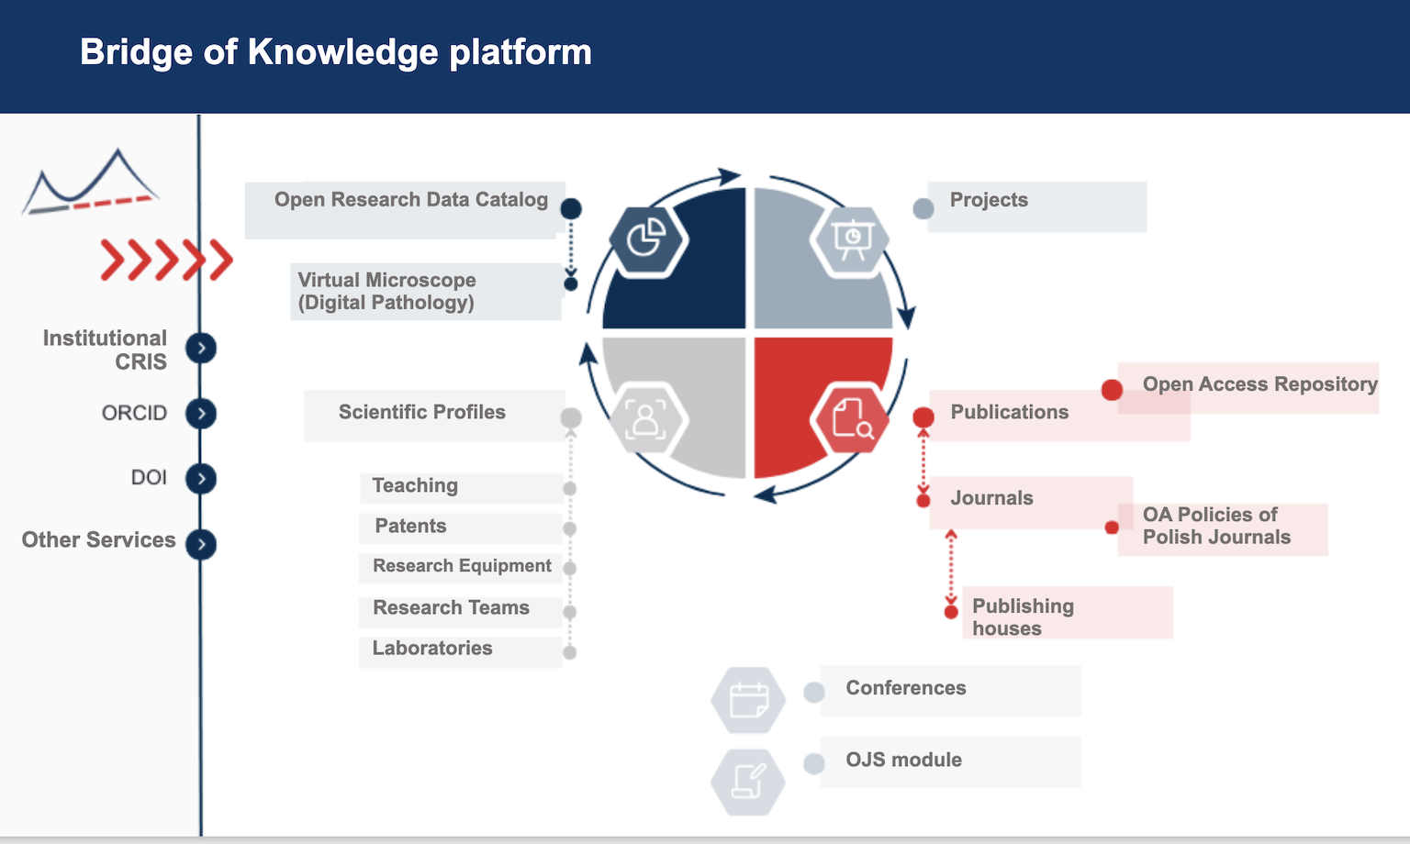
9th Erasmus Staff Training Week
Gdańsk Tech Library
2025
Podpis

Slide 11


9th Erasmus Staff Training Week
Gdańsk Tech Library
2025
Key Projects Supporting Open Science and FAIR Data in Poland
Interdisciplinary Data Sharing Standards
  The project “Data practices in an interdisciplinary perspective” analyzes data sharing challenges and workflows in architecture, civil engineering, economics, and NLP.
  It contributes to the RDA knowledge base by comparing data practices across disciplines, including social aspects and metadata standards.
Integration with the EOSC Portal and FAIR-IMPACT Support
  The MOST WIEDZY Open Research Data Catalog is being integrated into the EOSC Marketplace.
  Through the FAIR-IMPACT open call, researchers will assess and improve the FAIRness of their datasets using tools like F-UJI, FOOPS, and FAIR Maturity Models.
Creating Persistent Identifier (PID) Policies
  As part of EOSC-aligned activities, efforts are made to develop and self-assess PID policies using the FAIRCORE4EOSC Compliance Assessment Toolkit.
  This fosters consistency and interoperability in research output identification.
https://pg.edu.pl/en/gdansk-tech-library

Slide 12

9th Erasmus Staff Training Week
Gdańsk Tech Library
2025
Promoting Open Research Data at Gdańsk University of Technology - Excellence initiative - research university (IDUB)
  A dedicated initiative aims to raise awareness and skills in data publishing among researchers and PhD students.
  Key focus: training data stewards to support disciplines and boost the visibility and quality of research.
FIDELIS – Network of Trustworthy Digital Repositories
  Under Horizon Europe (2025–2027), the FIDELIS project will create a sustainable network of EOSC-aligned trustworthy repositories.
  Gdańsk University of Technology leads training and mentoring efforts for repository development across Europe.
https://pg.edu.pl/en/gdansk-tech-library

Slide 13

History is wisdom – future is challenge
Thank you

